Slide 1
Lecture 8
Reaction Kinetics

Slide 2

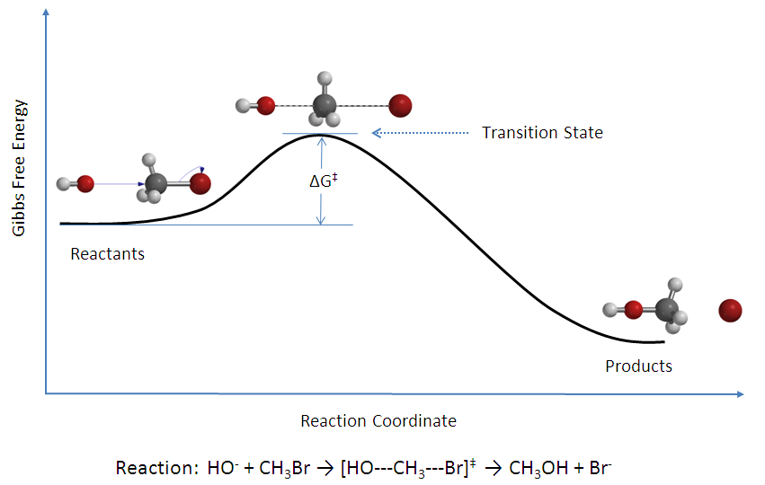
Reaction Kinetics
Chemical kinetics focus:
Models which predict rates
Reaction pathways and determination of possible transition states
Effect of reaction conditions on rates and pathway
The kinetics of a reaction are more difficult to predict than the thermodynamics.

Slide 3
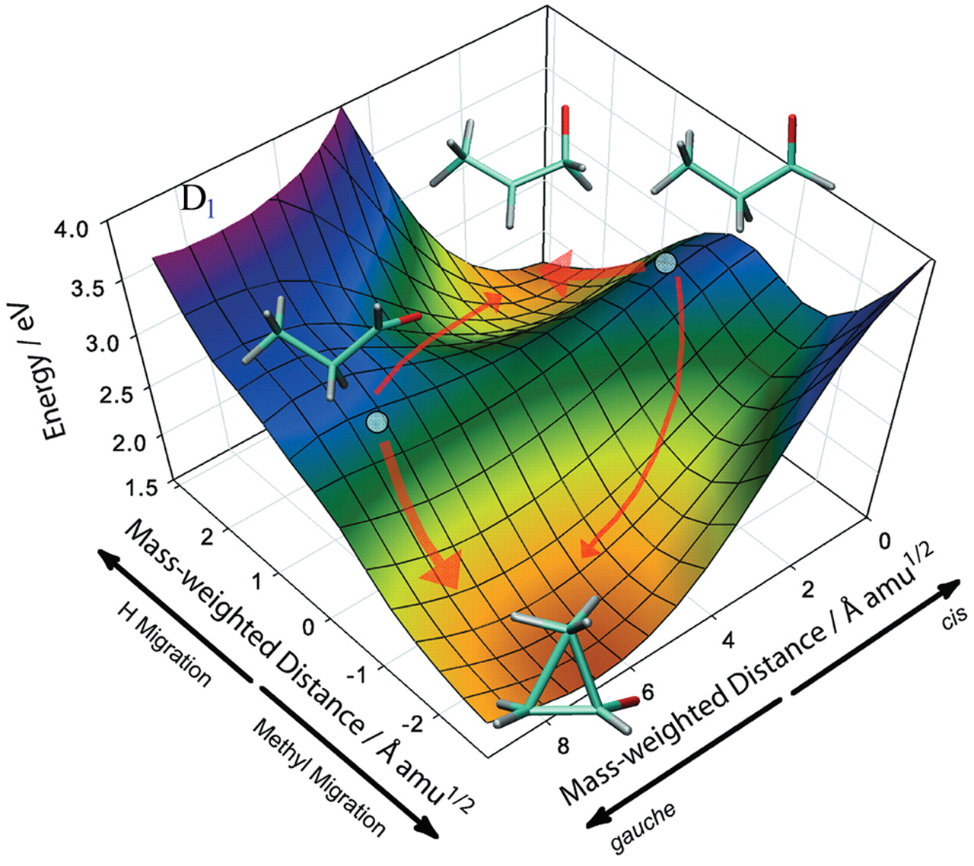
Rate Modeling with Transition State Theory
Transition State Theory Assumptions:
TST assumes the existence of:
PES
A dividing surface
Critical TS on the dividing surface
Quasi-equilibrium between the reactants and TS
Harmonic form of the PEs near the TS
Two-dimensional cut of the D1 PES for propanal cation showing reaction pathways from the Franck-Condon point (shown as a solid circle for each of the cis and gauche conformers) to the hydrogen-migration and methyl-migration minima for cis and gauche conformers.
Kim, M., Shen, L. , Hongli, T., Martinez, T., Suits, A. Science, Mar 2007, Conformationally Controlled Chemistry Excited-State Dynamics Dictate Ground-State Reaction

Slide 4
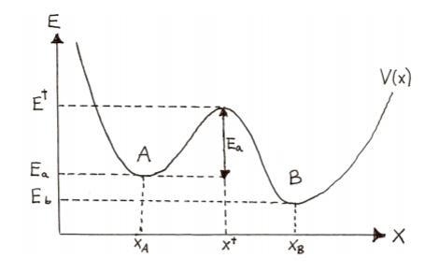
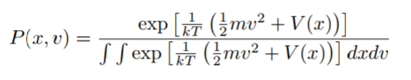

Rate Constant Derivation from Stat. Mech.
Key assumption:
A particle moving to the right of the TS will end up a product and a particle moving to the left will end up a reactant. Describe particle motion using Boltzmann Distr.

Slide 5
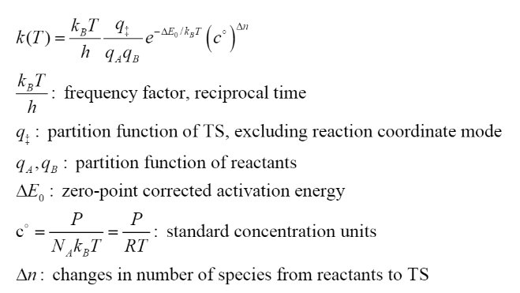
TST Rate Constant

